Slide 1
Request for Proposals for the Registry Operation of the Country Code Top Level Domain of Colombia
(ccTLD .CO)
Montréal, Canada
November 2019

Slide 2
Agenda
Background Information
Public Tender Process Guidelines
New Contract Characteristics

Slide 3
Background Information:
History of the ccTLD .CO
Administration
1991
University of los Andes is designated by IANA
Colombian NIC.
2009
Public Tender Process
2010
.CO Internet S.A.S. Selected
Concession Contract
2019
Public Tender Process
2020
New operator Selection
New administration model - Operation Contract

Slide 4
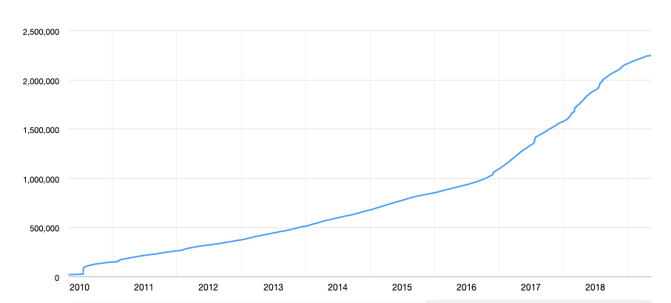
Background information: Domain registrations in .CO zone: 2,246,670 as of October 2019.
Data source: (https://domainnamestat.com/statistics/tld/co-TLD_ID-1287)

Slide 5
Background information: 2019 public tender process
Ministry objectives:
Operation of the Colombian Country Code Top Level Domain under the best international practices. Stability and security are priorities.
Offer world-class service to the national and international users of the top level domain, as well as to the global internet community.
Align the incentives of the Ministry and the operator, to enhance the operation and growth of the ccTLD .CO
Have an active role in the managment of the top level domain.
Update the technical, financial and legal conditions of the operation contract.

Slide 6
2020 .co Operation Scheme
Ministry Registrar Acreditation
Operation Contract
Private Agreement

Slide 7
2020 Contract Characteristics
Operate the registry services. This includes DNS, EPP, WHOIS RDAP, security extensions and a local node.
66
months. 6 months for the transition process and 60 months for the operation of the ccTLD.
Retribution for the Operator is a percentage of the gross income. Economic incentive for the growth of the ccTLD .co
Security and abuse prevention
Promotion and marketing
Transition process

Slide 8
2020 Contract Characteristics
Trust
Operator’s
Account
Registry System Account
MinTIC’s
Account
System Backup Sub-Account
Reserve Sub-Account
Supervision Sub-Account
EBERO
ICANN

Slide 9
Minimum Technical Requirements (pass or fail)
Managed a Top Level Domain with at least 2 million registrations during two (2) continuous years.
Operated DNS data bases with not less than an average of 25 million daily transactions during one month.
Commercial relationship with at least 1.500 registrars of which not less than ten (10) are of the biggest 25 worldwide.
Took part of a TLD transition process with minimum 1 million registrations in a single ccTLD or various gTLD.
Participants are allowed to claim the experience of its parent company or another affiliate company

Slide 10
Minimun Financial Requirements (pass or fail)
$Current Ratio=\frac{Current Assets }{Current Liabilities}$≥ 1.2
$Working Capital=Current Assts −Current Liabilities≥COP 25 billion (USD 7.3 million aprox)$
$Interest to EBITDA=\frac{Total Interests }{EBITDA}$≥2
$Net Worth=Total Asstets −Total Liabilities=COP 27 billion (USD 7.7 million approx)$
$Debt ratio=\frac{Total Assets }{Total Liabilities}$≤70%
In addition to the financial requirements, the respondent must demonstrate these additional ratios to support its organizational capabilities”
$$ROA=\frac{Operational profit }{Total Assets}>0$$
$$ROE=\frac{Operational profit }{Equity}>0$$

Slide 11
Evaluation Criteria
$$Evaluation Formula: TS=EP+ TP+NIS+HW$$
Evaluation Criteria | Maximum Score
TS: Total score of the respondent | 100
EP: Economic Proposal | 70
TP: Technical Proposal | 19
NIS: National Industry Score | 10
HW: Handicap Workers score | 1

Slide 12
2019 Public Tender Process: Evaluation Criteria
Technical Proposal
Economic Proposal
Each respondent will submit a service-level proposal for the KPIs of:
DNS Service
RDDS/WHOIS Service
EPP Service
There are 3 alternatives for each KPI (9 in total)
Each service-level proposal will receive a score, according to the tender process terms of reference.
Each respondent must offer a retribution for the operation services, as a percentage (%) of the gross income of the project.
Top limit of 74%
The econmic proposal with the lowest percentage will get the higest score. The others will score proportionally.
The respondent must demostrate it has:
An infrastructure of exchange nodes in at least twenty (20) locations in not less than five (5) continents.
Have security systems for DNS services that include at least one thousand (1.000) registered zones in DNSSEC.

Slide 13
Some practicalities of the process
The contract is subject to the Colombian law
All documents are in Spanish
Public documents will require translation and apostille or legalization
Private documents only require translation
A draft of the contract documents is available for comments until 21/11/2019
The tender process is going to take place via the Colombian Public Procurement Electronic System –SECOP II-. All respondents must submit there offers through SECOP II.
However, the economic proposal must be submitted in a physical, sealed envelope.
National industry score and handicap workers score are Colombian mandatory public tender process evaluation criteria.
To find the drafts of the documents and all relevant information:
1. Go to https://micrositios.mintic.gov.co/dominio.co/
2. For the draft documents, go to SECOP II
3. Look for process number: MTIC-LP-01-2019

Slide 14
2019
Ministerio de Tecnologías de la Información y las Comunicaciones
Tel:+57(1) 344 34 60
Edif. Murillo Toro Cra. 8a entre calles 12 y 13, Bogotá, Colombia - Código Postal 111711
www.mintic.gov.co

